Slide 1
DATA REPRESENTATION

Slide 2
Data Representation- Integer-Fixed point
Unsigned Number
Signed Number
One’s Complement
Two’s Complement
Biased one(Not Commonly used)

Slide 3
Data Representation
Binary
Octal
Fixed Point
Instructions
Numerical
Decimal
Information
Floating Point
Data
Hexa Decimal
Non Numeric

Slide 4
Cont
Unsigned numbers: only non-negative values.
Signed numbers: include all values (positive and negative).
There are three common ways of representing signed numbers (positive and negative numbers) for binary numbers:
  Sign-and-Magnitude
  1s Complement
  2s Complement

Slide 5
Sign-and-Magnitude
Negative numbers are usually written by writing a minus sign in front.
  Example:
  - (12)₁₀ , - (1100)₂
In sign-and-magnitude representation, this sign is usually represented by a bit:
  0 for +
  1 for -

Slide 6
Negative Numbers:
Sign-and-Magnitude (Cont’)
Example: an 8-bit number can have 1-bit sign and 7-bit magnitude.
sign
magnitude

Slide 7
Signed magnitude representation (cont’)
.
Examples:
1101₂ = 13₁₀ (a 4-bit unsigned number)
0 1101 = +13₁₀ (a positive number in 5-bit signed magnitude)
1 1101 = -13₁₀ (a negative number in 5-bit signed magnitude)
0100₂ = 4₁₀ (a 4-bit unsigned number)
0 0100 = +4₁₀ (a positive number in 5-bit signed magnitude)
1 0100 = -4₁₀ (a negative number in 5-bit signed magnitude)

Slide 8
Negative Numbers:
Sign-and-Magnitude (Cont’)
To negate a number, just invert the sign bit.
Examples:
- (0 0100001)_{sm} = (1 0100001)_{sm}
- (1 0000101)_{sm} = (0 0000101)_{sm}

Slide 9
1s and 2s Complement
Two other ways of representing signed numbers for binary numbers are:
  1s-complement
  2s-complement
They are preferred over the simple sign-and-magnitude representation.

Slide 10
One’s complement representation
A different approach, one’s complement, negates numbers by complementing each bit of the number.
We keep the sign bits: 0 for positive numbers, and 1 for negative. The sign bit is complemented along with the rest of the bits.
Examples:
1101₂ = 13₁₀ (a 4-bit unsigned number)
0 1101 = +13₁₀ (a positive number in 5-bit one’s complement)
1 0010 = -13₁₀ (a negative number in 5-bit one’s complement)
0100₂ = 4₁₀ (a 4-bit unsigned number)
0 0100 = +4₁₀ (a positive number in 5-bit one’s complement)
1 1011 = -4₁₀ (a negative number in 5-bit one’s complement)

Slide 11

Why is it called “one’s complement?”
Complementing a single bit is equivalent to subtracting it from 1.
0’ = 1, and 1 - 0 = 1 1’ = 0, and 1 - 1 = 0
Similarly, complementing each bit of an n-bit number is equivalent to subtracting that number from 2^{n}-1.
For example, we can negate the 5-bit number 01101.
  Here n=5, and 2^{n}-1 = 31₁₀ = 11111₂.
  Subtracting 01101 from 11111 yields 10010:
1 1 1 1 1
- 0 1 1 0 1
1 0 0 1 0

Slide 12
1s Complement Addition/Subtraction
Algorithm for addition, A + B:
Perform binary addition on the two numbers.
If there is a carry out of the MSB, add 1 to the result.
Check for overflow: Overflow occurs if result is opposite sign of A and B.
Algorithm for subtraction, A – B:
A – B = A + (–B)
Take 1s complement of B by inverting all the bits.
Add the 1s complement of B to A.

Slide 13
One’s complement addition
To add one’s complement numbers:
  First do unsigned addition on the numbers, including the sign bits.
  Then take the carry out and add it to the sum.
Two examples:
This is simpler and more uniform than signed magnitude addition.
0011 (+3)
+ 0010 + (+2)
0 0101
0101
+ 0
0101 (+5)
0111 (+7)
+ 1011 + (-4)
1 0010
0010
+ 1
0011 (+3)

Slide 14
Two’s complement
Our final idea is two’s complement. To negate a number, complement each bit (just as for ones’ complement) and then add 1.
Examples:
1101₂ = 13₁₀ (a 4-bit unsigned number)
0 1101 = +13₁₀ (a positive number in 5-bit two’s complement)
1 0010 = -13₁₀ (a negative number in 5-bit ones’ complement)
1 0011 = -13₁₀ (a negative number in 5-bit two’s complement)
0100₂ = 4₁₀ (a 4-bit unsigned number)
0 0100 = +4₁₀ (a positive number in 5-bit two’s complement)
1 1011 = -4₁₀ (a negative number in 5-bit ones’ complement)
1 1100 = -4₁₀ (a negative number in 5-bit two’s complement)

Slide 15
2s Complement Addition/Subtraction
S. BALAMURUGAN- VIT UNIVERSITY
Algorithm for addition, A + B:
Perform binary addition on the two numbers.
Ignore the carry out of the MSB (most significant bit).
Check for overflow: Overflow occurs if the ‘carry in’ and ‘carry out’ of the MSB are different, or if result is opposite sign of A and B.
Algorithm for subtraction, A – B:
A – B = A + (–B)
Take 2s complement of B by inverting all the bits and adding 1.
Add the 2s complement of B to A.

Slide 16
2s Complement Addition/Subtraction
Examples: 4-bit binary system
Which of the above is/are overflow(s)?
+3 0011
+ +4 + 0100
---- -------
+7 0111
---- -------
-2 1110
+ -6 + 1010
---- -------
-8 11000
---- -------
+6 0110
+ -3 + 1101
---- -------
+3 10011
---- -------
+4 0100
+ -7 + 1001
---- -------
-3 1101
---- -------

Slide 17
Overflow
If the numbers are unsigned, overflow occurs when there is a
carry out of the most significant bit
For signed numbers, overflow detected by comparing the sign of the result against the sign of the numbers
If one number is positive and another is negative, overflow
cannot occur
If both are positive or both are negative, compare the carry
into the sign bit and carry out of the sign bit
If these two carries are not equal, then there is an overflow

Slide 18
Signed overflow
Subtraction (lvk)
With two’s complement and a 4-bit adder, for example, the largest represent able decimal number is +7, and the smallest is -8.
What if you try to compute 4 + 5, or (-4) + (-5)?
We cannot just include the carry out to produce a five-digit result, as for unsigned addition. If we did, (-4) + (-5) would result in +23!
Also, unlike the case with unsigned numbers, the carry out cannot be used to detect overflow.
  In the example on the left, the carry out is 0 but there is overflow.
  Conversely, there are situations where the carry out is 1 but there is no overflow.
0 1 0 0 (+4)
+ 0 1 0 1 (+5)
0 1 0 0 1 (-7)
1 1 0 0 (-4)
+ 1 0 1 1 (-5)
1 0 1 1 1 (+7)

Slide 19
Detecting signed overflow
Subtraction (lvk)
The easiest way to detect signed overflow is to look at all the sign bits.
Overflow occurs only in the two situations above:
  If you add two positive numbers and get a negative result.
  If you add two negative numbers and get a positive result.
Overflow cannot occur if you add a positive number to a negative number. Do you see why?
0 1 0 0 (+4)
+ 0 1 0 1 (+5)
0 1 0 0 1 (-7)
1 1 0 0 (-4)
+ 1 0 1 1 (-5)
1 0 1 1 1 (+7)

Slide 20
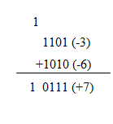
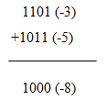
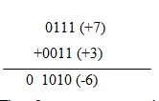
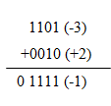
Signed Overflow
carry and overflow
carry generated, but no overflow
no carry and overflow
no carry and no overflow

Slide 21
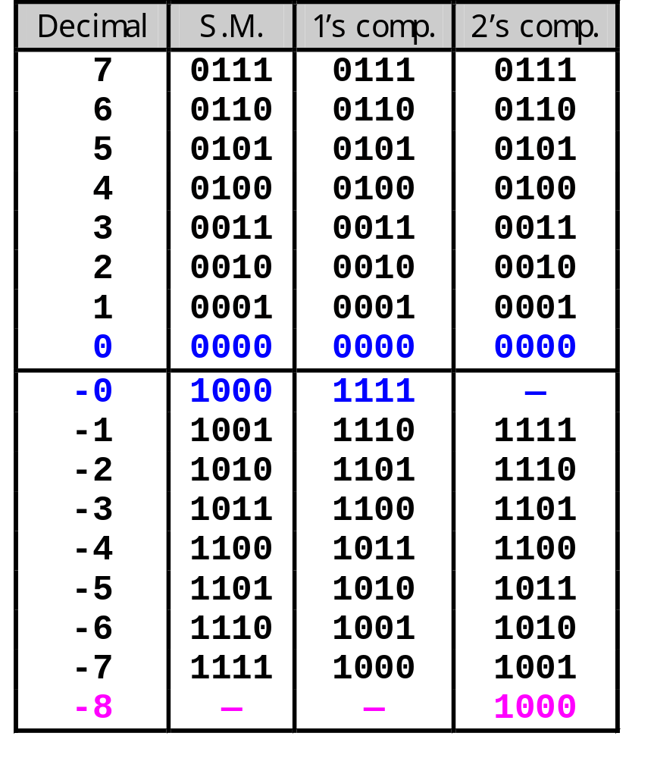
Comparing the signed number systems
Here are all the 4-bit numbers in the different systems.
Positive numbers are the same in all three representations.
Signed magnitude and one’s complement have two ways of representing 0. This makes things more complicated.
Two’s complement has asymmetric ranges; there is one more negative number than positive number. Here, you can represent -8 but not +8.
However, two’s complement is preferred because it has only one 0, and its addition algorithm is the simplest.

Slide 22
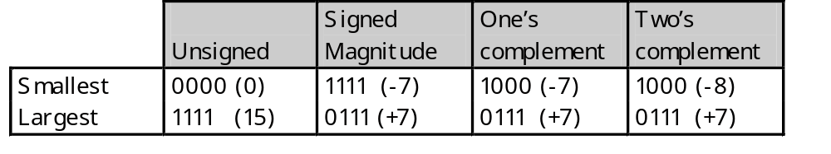
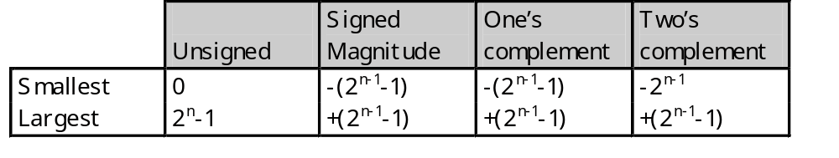
Ranges of the signed number systems
How many negative and positive numbers can be represented in each of the different systems on the previous page?
In general, with n-bit numbers including the sign, the ranges are:

Slide 23
Fixed Point Numbers
The signed and unsigned numbers representation given are fixed point numbers.
The binary point is assumed to be at a fixed location, say, at the end of the number:
Can represent all integers between –128 to 127 (for 8 bits).
binary point

Slide 24
Pros and cons of integer representation
Signed magnitude representation:
  2 representations for 0
  Simple
  255 different numbers can be represented.
  Need to consider both sign and magnitude in arithmetic
  Different logic for addition and subtraction
1’s complement representation:
  2 representations for 0
  Complexity in performing addition and subtraction
  255 different numbers can be represented.
2’s complement representation:
  Only one representation for 0
  256 different numbers can be represented.
  Arithmetic works easily
  Negating is fairly easy

Slide 25
Reference
Morris Mano, “Computer System Architecture”, Pearson Education, 3rd edition (Chapter 3)
William Stallings “Computer Organization and architecture”, Prentice Hall, 7th edition,2006.(chapter 9)
http://acad.intranet.vit.ac.in/CoursePage/COURSEPAGE-DUMP/EEE116%20Digital%20Logic%20System%20Design/Prof.%20Balamurugan%20%20S/Unit-I-Number%20system%20and%20Codes.ppt

Slide 26
RISC AND CISC ARCHITECTURE

Slide 27
RISC
RISC :- Reduced Instruction Set Computer Processor
A microprocessor architecture with a simple collection and highly customized set of instructions.
It is built to minimize the instruction execution time by optimizing and limiting the number of instructions.
It means each instruction cycle requires only one clock cycle, and each cycle contains three parameters: fetch, decode and execute.
RISC chips require several transistors, making it cheaper to design and reduce the execution time for instruction.

Slide 28
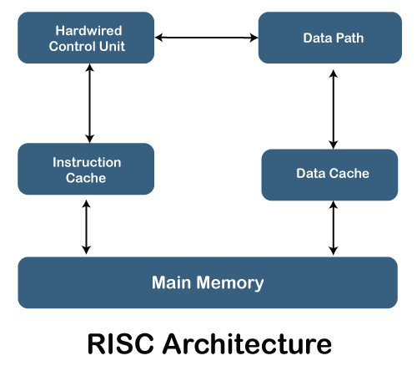
RISC Architecture

Slide 29
Features of RISC Processor
One cycle execution time: For executing each instruction in a computer, the RISC processors require one CPI (Clock per cycle).
Pipelining technique: The pipelining technique is used in the RISC processors to execute multiple parts or stages of instructions to perform more efficiently.
A large number of registers: RISC processors are optimized with multiple registers that can be used to store instruction and quickly respond to the computer and minimize interaction with computer memory.
It supports a simple addressing mode and fixed length of instruction for executing the pipeline.
It uses LOAD and STORE instruction to access the memory location.
Simple and limited instruction reduces the execution time of a process in a RISC.

Slide 30
CISC
CISC:-Complex Instruction Set Computer
It has a large collection of complex instructions that range from simple to very complex and specialized in the assembly language level, which takes a long time to execute the instructions.
CISC approaches reducing the number of instruction on each program and ignoring the number of cycles per instruction.
CISC chips are relatively slower as compared to RISC chips but use little instruction than RISC.

Slide 31
Features of CISC Processor
The length of the code is shorts, so it requires very little RAM.
CISC or complex instructions may take longer than a single clock cycle to execute the code.
Less instruction is needed to write an application.
It provides easier programming in assembly language.
Support for complex data structure and easy compilation of high-level languages.
It is composed of fewer registers and more addressing modes, typically 5 to 20.
Instructions can be larger than a single word.
It emphasizes the building of instruction on hardware because it is faster to create than the software.

Slide 32
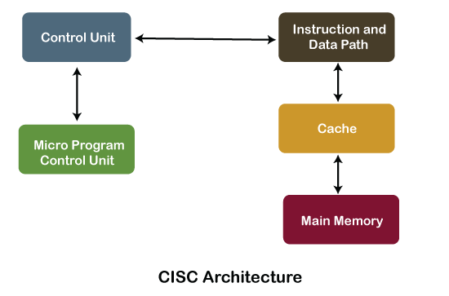
CISC Architecture

Slide 33
RISC | CISC
1. RISC stands for Reduced Instruction Set Computer. | 1. CISC stands for Complex Instruction Set Computer.
2. RISC processors have simple instructions taking about one clock cycle. The average clock cycle per instruction (CPI) is 1.5 | 2. CSIC processor has complex instructions that take up multiple clocks for execution. The average clock cycle per instruction (CPI) is in the range of 2 and 15.
3. Performance is optimized with more focus on software | 3. Performance is optimized with more focus on hardware.
4. It has no memory unit and uses separate hardware to implement instructions.. | 4. It has a memory unit to implement complex instructions.
5. It has a hard-wired unit of programming. | 5. It has a microprogramming unit.
6. The instruction set is reduced i.e. it has only a few instructions in the instruction set. Many of these instructions are very primitive. | 6. The instruction set has a variety of different instructions that can be used for complex operations.
7. Complex addressing modes are synthesized using the software. | 7. CISC already supports complex addressing modes
8. Multiple register sets are present | 8. Only has a single register set
9. RISC processors are highly pipelined | 9. They are normally not pipelined or less pipelined
10. The complexity of RISC lies with the compiler that executes the program | 10. The complexity lies in the microprogram
11 Execution time is very less | 11. Execution time is very high
12. Code expansion can be a problem | 12. Code expansion is not a problem
13. The decoding of instructions is simple. | 13. Decoding of instructions is complex
14. The most common RISC microprocessors are Alpha, ARC, ARM, AVR, MIPS, PA-RISC, PIC, Power Architecture, and SPARC. | 14. Examples of CISC processors are the System/360, VAX, PDP-11, Motorola 68000 family, AMD, and Intel x86 CPUs.
15. RISC architecture is used in high-end applications such as video processing, telecommunications, and image processing. | 15. CISC architecture is used in low-end applications such as security systems, home automation, etc.

